Slide 1

Team
Divya Vemula
Mani Krishna Tippani
Rahul Chauhan
Shaheryar Nadeem

Slide 2
Executive Summary
Introduction
Methodology
Results
Conclusion
Appendix
Introduction

Slide 3
Objective:
Predict the success of Falcon 9 first-stage landings to optimize launch costs and improve mission planning.
Key Findings:
Launch Sites:
CCAFS SLC 40 and KSC LC 39A have the highest success rates.
VAFB SLC 4E requires optimization for polar orbit missions.
Payload Insights:
Payloads between 0-8,000 kg have the highest success rates.
Heavier payloads (>12,000 kg) are more prone to failure.
Model Performance:
SVM is the best-performing model with 91% accuracy.
The model has no false negatives, ensuring all successful landings are identified.
Executive Summary

Slide 4
Introduction
Introduction
The objective of this project is to predict the success of SpaceX launches using machine learning models. By analyzing historical data on SpaceX launches, the goal is to determine the factors that influence whether a launch is successful or not.
Problem Statement
SpaceX's launch outcomes—whether a mission is successful or fails—have significant implications for future mission planning, resource allocation, and risk management. Accurately predicting the success or failure of future launches will enable better decision-making for SpaceX and other space exploration entities.

Slide 5

Section 1

Slide 6

Methodology
Executive Summary
Data collection methodology:
SpaceX API, Web Scrapping
Perform data wrangling
Wrangling: Cleaned missing values, encoded categorical variables.
Tools: Pandas, SQLite
Perform exploratory data analysis (EDA) using visualization and SQL
Perform interactive visual analytics using Folium and Plotly Dash
Perform predictive analysis using classification models
How to build, tune, evaluate classification models

Slide 7
SpaceX API & Web Scraping: Used the SpaceX API to gather historical data on rocket launches, including information on launch sites, rocket types, outcomes, and more.
Web scraping techniques were also employed to supplement the data where API information was incomplete or unavailable.
Data Collection

Slide 8

Data Collection – SpaceX API
DataAPI
[Start] --> [Fetch SpaceX API Data] --> [Parse JSON Response] --> [Extract Relevant Data] --> [Data Wrangling] --> [Store Cleaned Data]

Slide 9
Data Collection - Scraping
DataScraping
[Start] --> [Target Website Identification] --> [Inspect HTML Structure] --> [Send HTTP Request] --> [Parse HTML Content] --> [Extract Required Data] --> [Data Cleaning] --> [Store Data] --> [End]

Slide 10
Data Wrangling
Data wrangling
Cleaning Missing Values: Identified and handled missing values using imputation or removal techniques to ensure dataset completeness.
Encoding Categorical Variables: Categorical variables like 'Outcome', 'LaunchSite', etc., were encoded using techniques like label encoding to convert them into machine-readable formats.
Tools Used: Pandas: For data manipulation and cleaning.
SQLite: For storing and querying cleaned data.
[Start] --> [Data Collection (API/Web Scraping)]
--> [Handle Missing Values] --> [Data Transformation]
--> [Feature Engineering] --> [Data Encoding]
--> [Outlier Detection] --> [Data Aggregation]
--> [Final Cleaned Dataset] --> [End]

Slide 11
Add
EDA with data visualization
Pie
Pie Chart - Launch Outcome Distribution: To visualize the distribution of launch outcomes (e.g., successful, failed) across the dataset.
Count
Bar Chart - Monthly Launch Success Count: To visualize the number of launches per outcome (e.g., successful, failed) each month for a given launch site or year.
Line
Line Plot - Trend of Successful Launches over Time: To visualize how the success rate of launches has changed over the years.
EDA with Data Visualization

Slide 12
Visualization: Used visualizations to identify trends, outliers, and correlations within the data.
Tools like Matplotlib, Seaborn, and Plotly were used to create bar charts, scatter plots, and histograms to understand the data better.
SQL Queries: Utilized SQL to perform aggregations, filter specific data points, and prepare the data for modeling.
EDA with SQL notebook
EDA with SQL

Slide 13
Build an Interactive Map with Folium
Markers: Essential for highlighting specific locations (launch sites) on the map. By providing a clickable marker, users can interact with the map to learn more about each site’s location and its associated launch details. This gives the map an intuitive, interactive quality.
Circles: Used to represent a visual safety or impact zone around each launch site. This is helpful for visualizing the geographical area that could be affected during a launch, such as evacuation or restricted zones. Adding different circle sizes for each launch site helps convey the range of influence.
Polylines: These lines represent the rocket’s trajectory, helping users to visually trace the rocket’s path and understand its destination. This is especially useful for users interested in the physics of rocket launches or the planning of the flight path.
Popups: These provide users with additional contextual information when interacting with map objects. By attaching popups to markers, circles, and polylines, we ensure that users can explore more details about each launch site, such as the date, rocket type, and outcome of the launch, without overwhelming the map with text.
Interactive map with Folium map

Slide 14
Pie Chart (Launch Success vs. Failure):
Purpose: The pie chart is an intuitive and visually appealing way to display categorical data. In this case, it helps users quickly understand the proportion of successful vs. failed launches. It simplifies the assessment of SpaceX’s overall launch performance for a specific site and year.
Bar Chart (Monthly Launch Outcomes):
Purpose: The bar chart provides detailed insights into the monthly trends of launch outcomes. It helps users observe fluctuations in the number of successful and failed launches over time, offering a more granular view of SpaceX's performance.
Launch Site Selection (Radio Buttons):
Purpose: The radio buttons give users control over which launch site’s data to visualize. This interaction makes the dashboard more dynamic and flexible, allowing users to easily switch between different sites without navigating away from the dashboard.
Year Selection (Dropdown):
Purpose: The dropdown allows users to filter the data based on the year of the launch. It gives users the ability to perform year-over-year comparisons and observe trends over time, which is crucial for understanding how SpaceX’s launch outcomes evolved.
Plotly Dash lab
Build a Dashboard with Plotly Dash

Slide 15
Data Collection → Data Preprocessing → Model Selection → Model Evaluation → Model Improvement → Best Performing Model (SVM)
Data Preprocessing: Handled missing values, encoded categorical variables, and scaled numerical features.
Model Selection: Tested four classification models: Logistic Regression, SVM, Decision Tree, and KNN.
Model Evaluation: Evaluated models using accuracy, confusion matrix, precision, recall, and F1 score.
Model Improvement: Tuned hyperparameters using GridSearchCV and applied cross-validation.
Best Performing Model: SVM achieved the highest accuracy of 91%.
predictive analysis
Predictive Analysis (Classification)

Slide 16
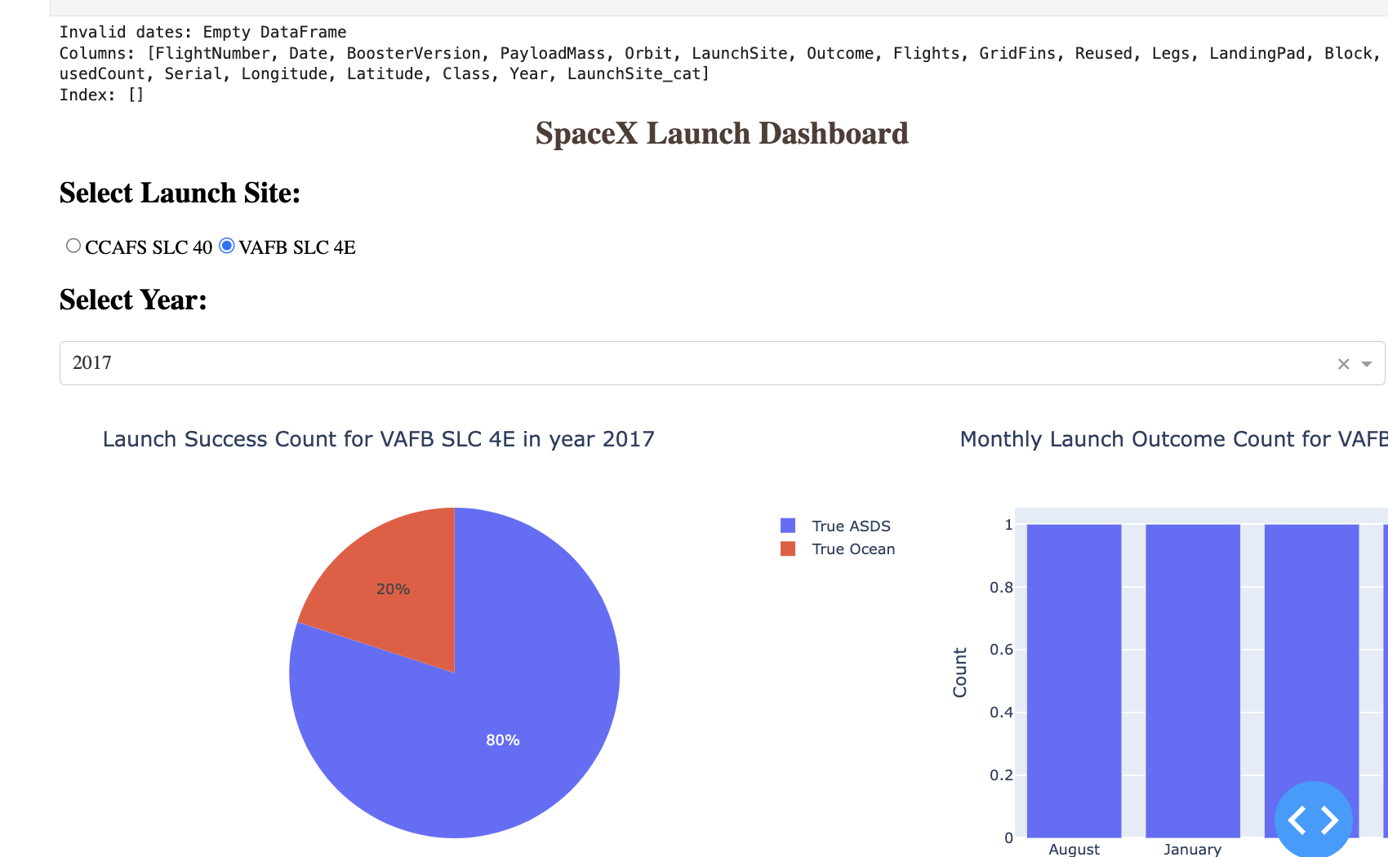
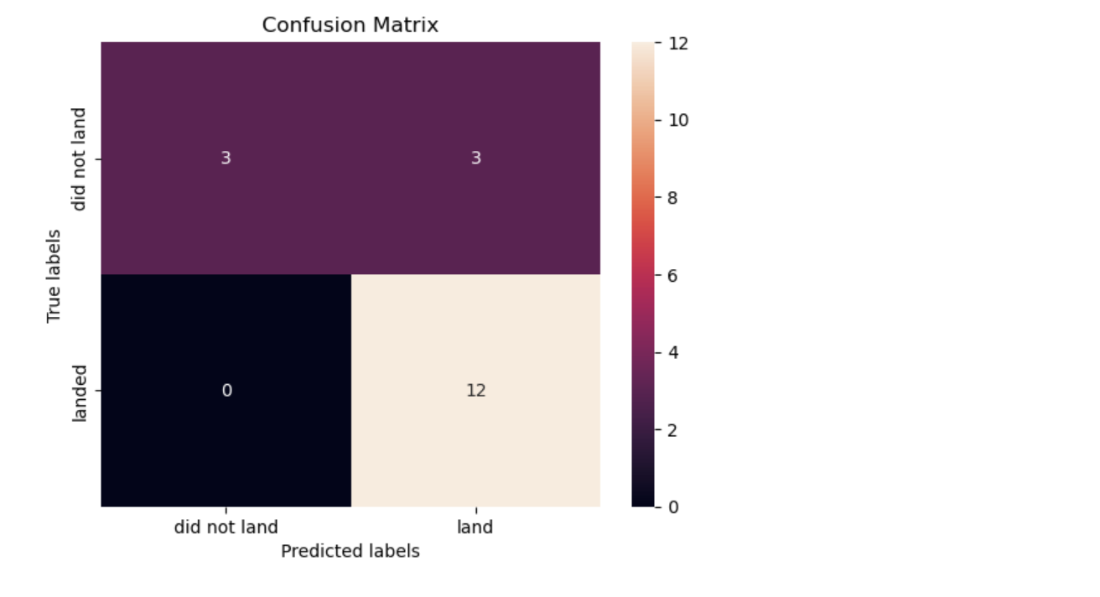
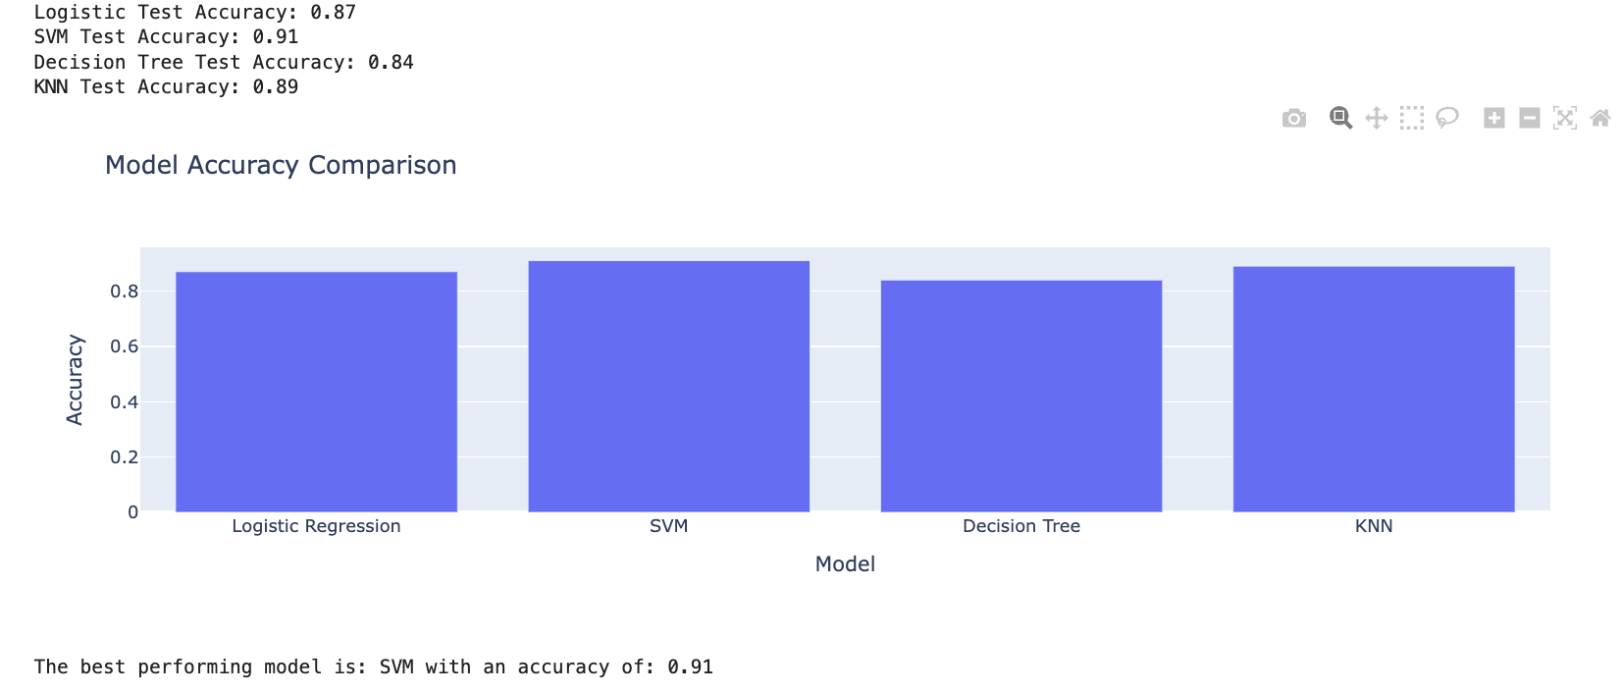
Results

Slide 17

Section 2

Slide 18
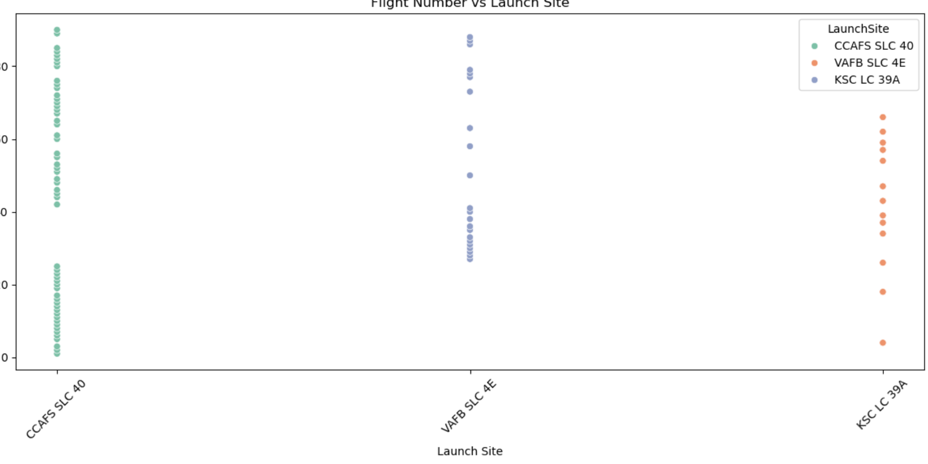
Flight Number vs. Launch Site
CCAFS SLC 40 is the most frequently used launch site, indicating high activity.
VAFB SLC 4E is used for polar orbits, showing fewer launches.
KSC LC 39A has increasing launches, likely for crewed missions.
Insight: CCAFS SLC 40 is SpaceX's primary site due to its strategic location.

Slide 19
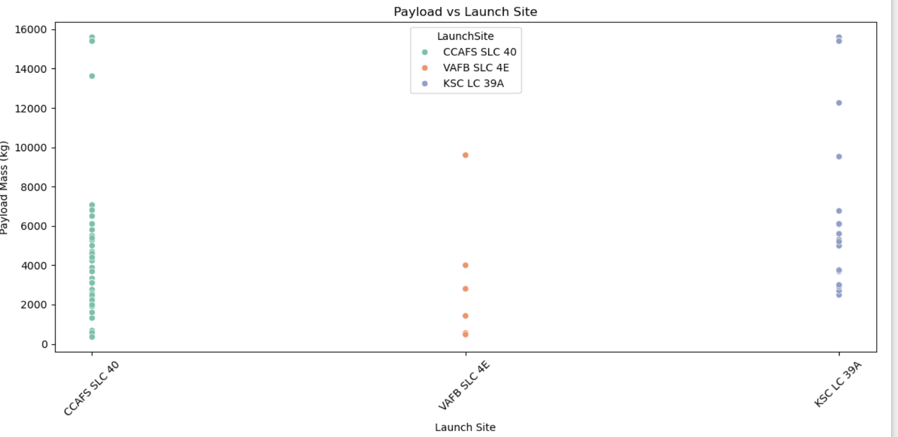
Payload vs. Launch Site
CCAFS SLC 40: Handles a wide range of payloads, from light to heavy, showing versatility.
VAFB SLC 4E: Primarily used for medium to heavy payloads, often for polar orbit missions.
KSC LC 39A: Focuses on heavy payloads, likely for high-profile or crewed missions.
Insight: CCAFS SLC 40 is the most versatile site, while KSC LC 39A is critical for heavy payloads.
Recommendation: Enhance KSC LC 39A for future heavy payload missions.

Slide 20
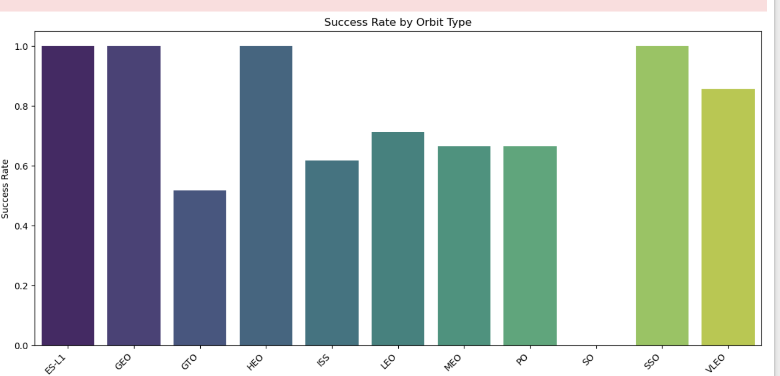
Success Rate vs. Orbit Type
Highest Success Rate: Orbits like LEO (Low Earth Orbit) and ISS (International Space Station) have high success rates (~90%).
Lowest Success Rate: GTO (Geostationary Transfer Orbit) has a lower success rate (~60-70%).
Insight: Success rates vary significantly by orbit type, with LEO being the most reliable.
Reason: GTO missions are more complex due to higher energy requirements.
Recommendation: Optimize launches for LEO and ISS orbits to maximize success rates.

Slide 21
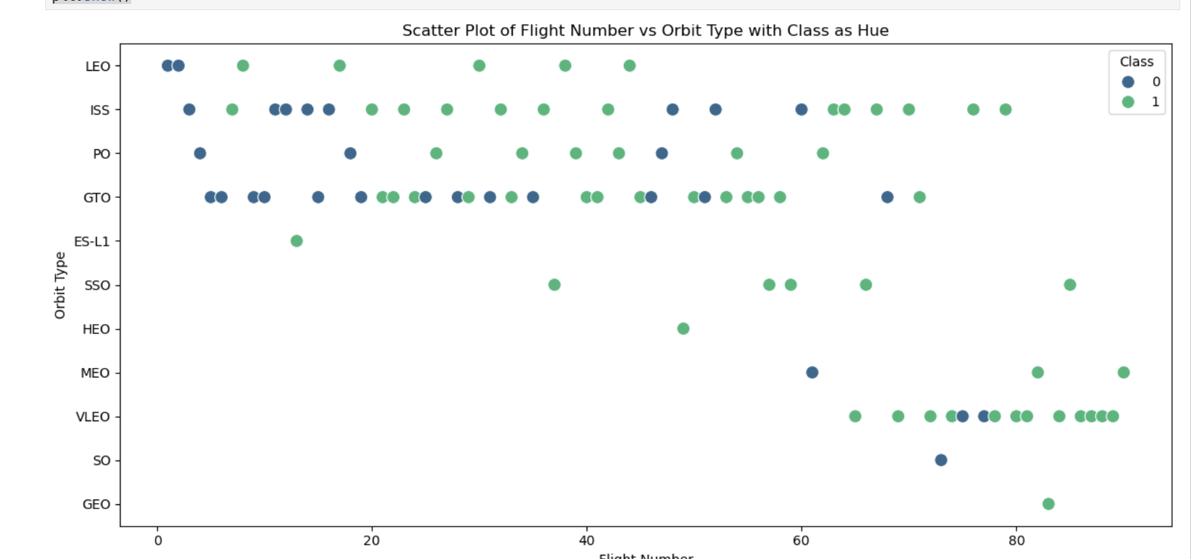
Flight Number vs. Orbit Type
Class 0 (Failure): Mostly concentrated in early flight numbers, especially for GEO and HEO orbits.
Class 1 (Success): Increases with higher flight numbers, particularly for LEO and ISS orbits.
Insight: Success rates improve over time, especially for simpler orbits like LEO.
Trend: Early flights had more failures, but later flights show consistent success.
Recommendation: Focus on optimizing GEO and HEO missions to improve success rates.

Slide 22
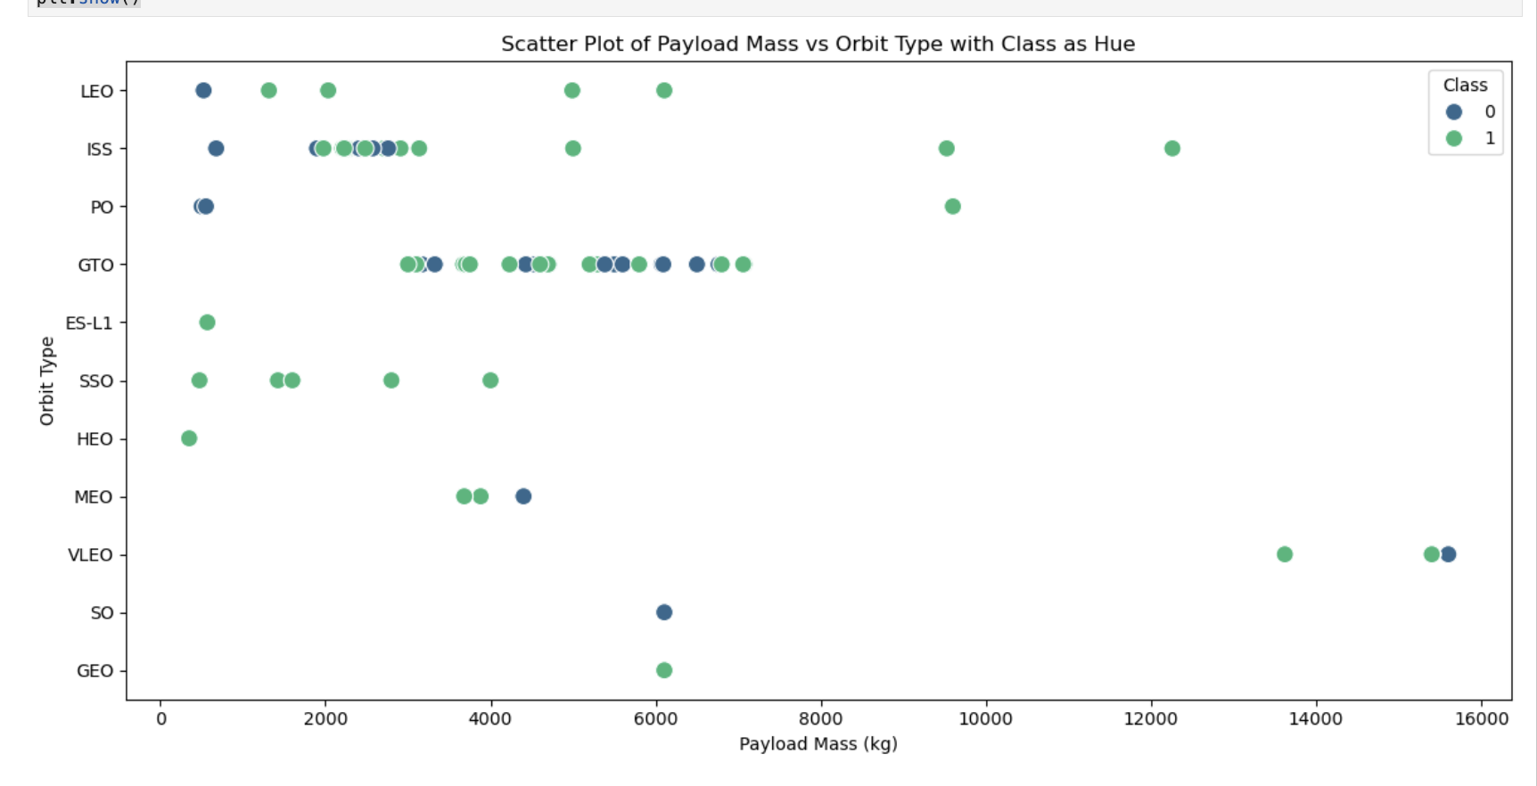
Payload vs. Orbit Type
Class 0 (Failure): Occurs across all payload masses but is more frequent in GEO and HEO orbits.
Class 1 (Success): Higher success rates for LEO and ISS orbits, especially with payloads between 2000-6000 kg.
Insight: Lighter payloads in LEO/ISS orbits have the highest success rates.
Trend: Heavier payloads in GEO/HEO orbits are more prone to failure.
Recommendation: Optimize payload mass for GEO/HEO missions to improve success rates.

Slide 23
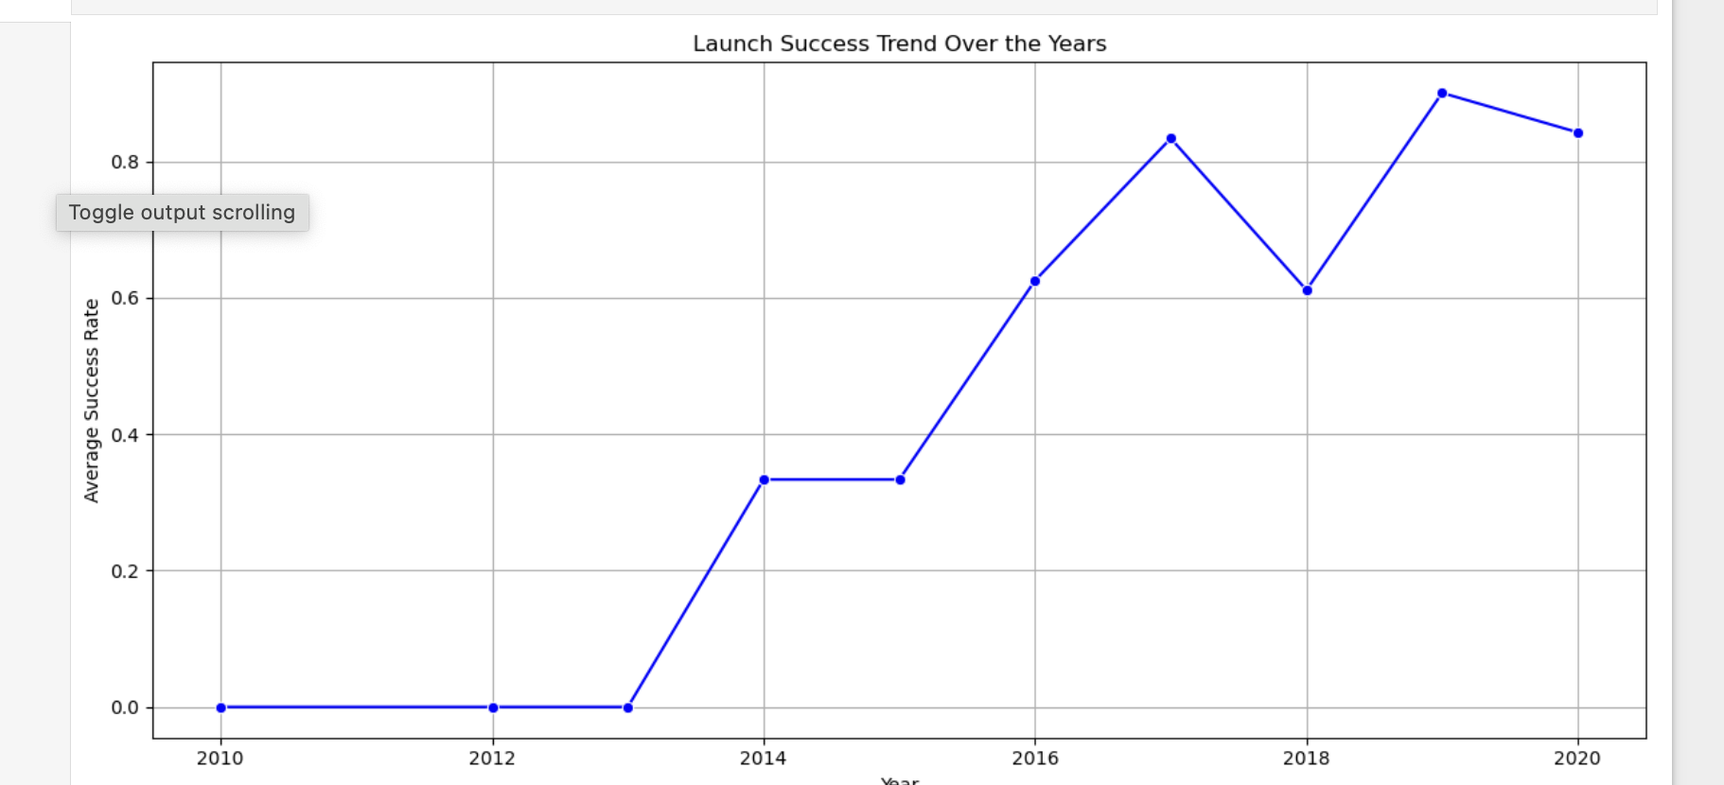
Launch Success Yearly Trend
Trend: Success rates improved significantly from ~40% in 2010 to ~90% in 2020.
Key Milestones: Major improvements around 2015-2017, likely due to technological advancements.
Insight: SpaceX has consistently increased launch reliability over the years.
Reason: Reusability and iterative design improvements.
Recommendation: Continue focusing on reusability and innovation to maintain high success rates.

Slide 24
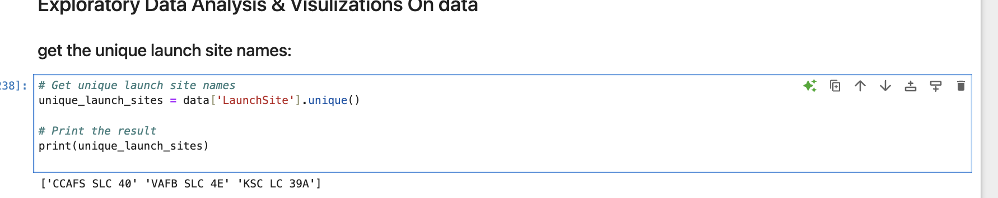
All Launch Site Names
Find the names of the unique launch sites
['CCAFS SLC 40' 'VAFB SLC 4E' 'KSC LC 39A']
Present your query result with a short explanation here
Explanation:
data['LaunchSite'].unique(): This will return the unique launch sites present in the LaunchSite column of the dataset.

Slide 25
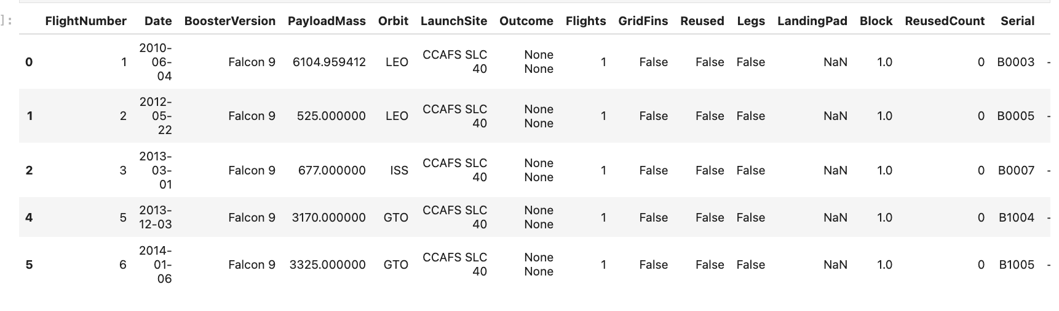
Launch Site Names Begin with 'CCA'
Find 5 records where launch sites begin with `CCA`
data_falcon9['LaunchSite'].str.startswith('CCA'): This filters the rows where the LaunchSite column starts with the string "CCA".
filtered_data.head(5): Displays the first 5 records from the filtered dataset.

Slide 26
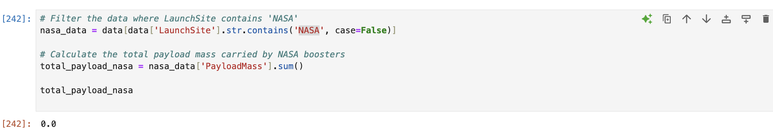
Total Payload Mass
Calculate the total payload carried by boosters from NASA
data['LaunchSite'].str.contains('NASA', case=False): Filters the data where the LaunchSite contains the string "NASA", ignoring case sensitivity.
nasa_data['PayloadMass'].sum(): Sums up the values in the PayloadMass column for the filtered dataset.
Since the data does not contain any references to NASA, the calculation you performed returned 0.0 because there are no matching records for NASA-based launch sites.

Slide 27
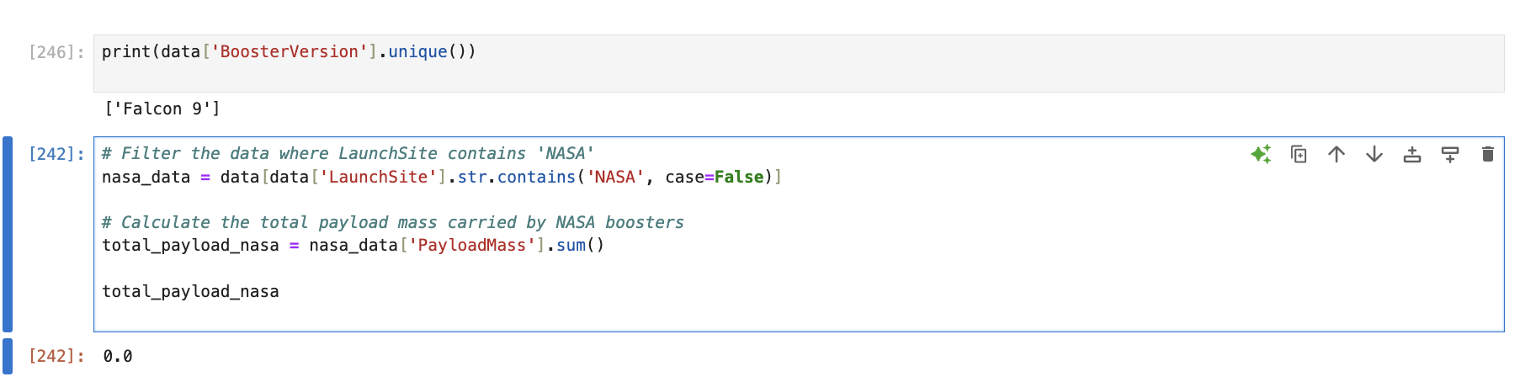
Average Payload Mass by F9 v1.1
Calculate the average payload mass carried by booster version F9 v1.1
This code will output the average payload mass carried by booster version "F9 v1.1." This value represents the mean of the PayloadMass for all launches that used this specific booster version.
It appears that the BoosterVersion column only contains the value 'Falcon 9' and does not include 'F9 v1.1'.
This means that the dataset doesn't have the specific booster version

Slide 28
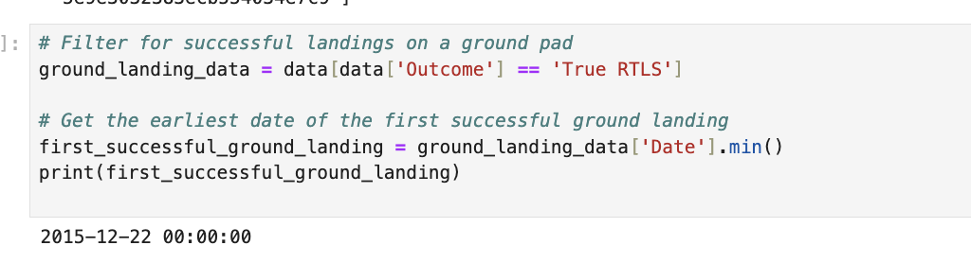
First Successful Ground Landing Date
Find the dates of the first successful landing outcome on ground pad
Present your query result with a short explanation here
Filtering the Data: We filter the data to include only rows where the Outcome is 'True RTLS', which represents successful ground landings. Finding the First Landing Date: We then use the .min() function on the Date column to find the earliest (first) successful ground landing date.

Slide 29
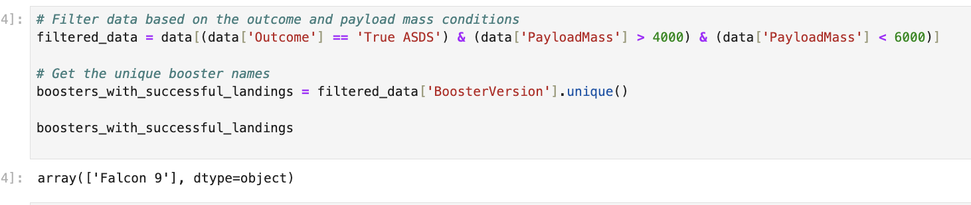
Successful Drone Ship Landing with Payload between 4000 and 6000
List the names of boosters which have successfully landed on drone ship and had payload mass greater than 4000 but less than 6000
Present your query result with a short explanation here
Filter the Data Based on Landing Outcome: We need to identify rows where the Outcome is 'True ASDS', which indicates a successful landing on an Autonomous Spaceport Drone Ship (ASDS). Filter Payload Mass: After filtering for successful ASDS landings, we need to further filter the data to only include those rows where the PayloadMass is between 4000 and 6000. Select Unique Booster Names: Finally, we will select the BoosterVersion to list the names of the boosters that meet both criteria.

Slide 30
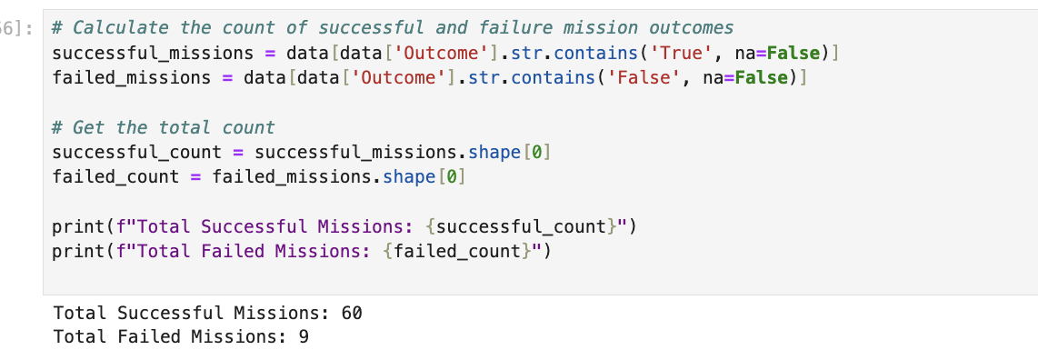
Total Number of Successful and Failure Mission Outcomes
Calculate the total number of successful and failure mission outcomes
successful_missions: Filters rows where the outcome contains 'True', indicating a successful mission.
failed_missions: Filters rows where the outcome contains 'False', indicating a failure.
shape[0]: Returns the number of rows (missions) in each filtered result.

Slide 31
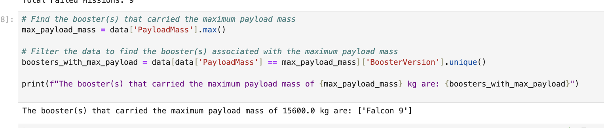
Boosters Carried Maximum Payload
List the names of the booster which have carried the maximum payload mass
max_payload_mass = data['PayloadMass’].
max(): This finds the maximum value in the PayloadMass column.
boosters_with_max_payload = data[data['PayloadMass'] == max_payload_mass]['BoosterVersion’].
unique(): This filters the dataset to find all the boosters associated with the maximum payload mass and returns their unique names.

Slide 32
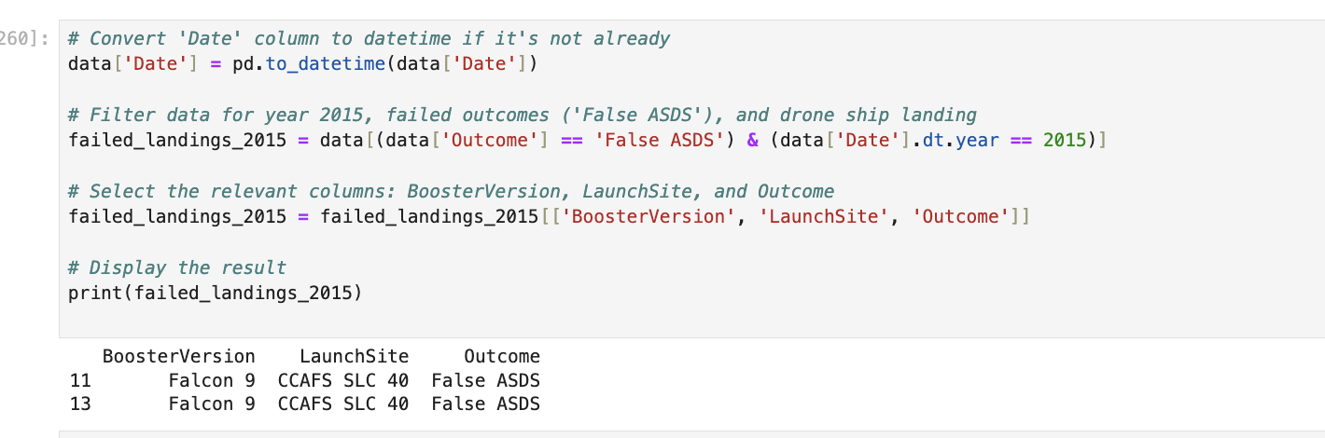
2015 Launch Records
List the failed landing_outcomes in drone ship, their booster versions, and launch site names for in year 2015
data['Date'] = pd.to_datetime(data['Date']): Ensures the Date column is in the correct datetime format.
data[(data['Outcome'] == 'False ASDS') & (data['Date’].
dt.year == 2015)]: Filters the data to only include records where the outcome is a failed landing on a drone ship ('False ASDS') and the year is 2015.
[['BoosterVersion', 'LaunchSite', 'Outcome']]: Selects the relevant columns for display.

Slide 33
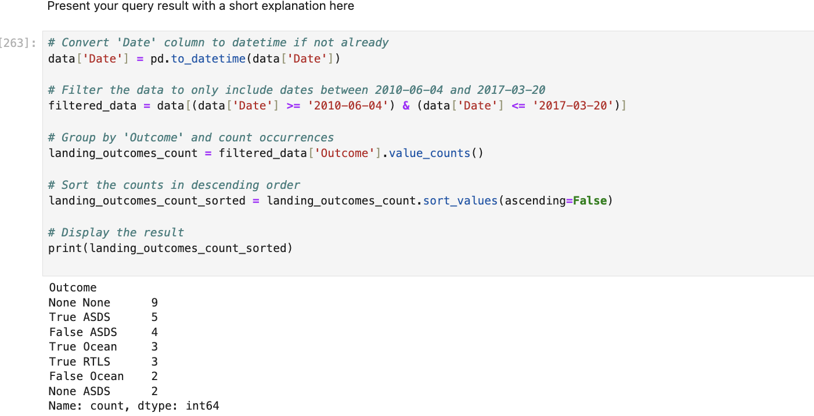
Rank Landing Outcomes Between 2010-06-04 and 2017-03-20
data['Date'] = pd.to_datetime(data['Date']): Ensures the Date column is in the correct datetime format.
(data['Date'] >= '2010-06-04') & (data['Date'] <= '2017-03-20'): Filters the data to include only records within the specified date range.
filtered_data['Outcome'].value_counts(): Counts the occurrences of each unique outcome (e.g., 'Success (ground pad)', 'Failure (drone ship)’).
sort_values(ascending=False): Sorts the outcome counts in descending order.

Slide 34

Section 3

Slide 35
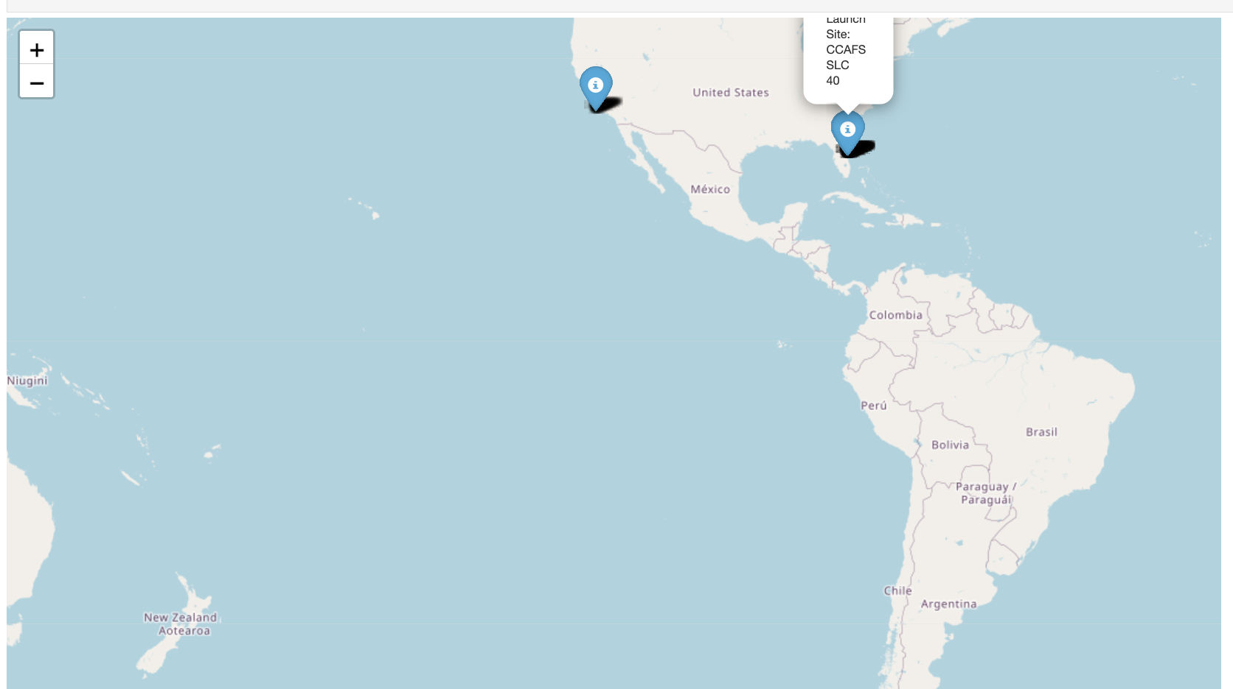
Global Launch Sites Locations
CCAFS SLC 40 and KSC LC 39A are located on the East Coast (Florida), ideal for equatorial launches.
VAFB SLC 4E is on the West Coast (California), optimized for polar orbits.
Insight: Launch sites are strategically placed to support different mission requirements (equatorial vs. polar orbits).

Slide 36
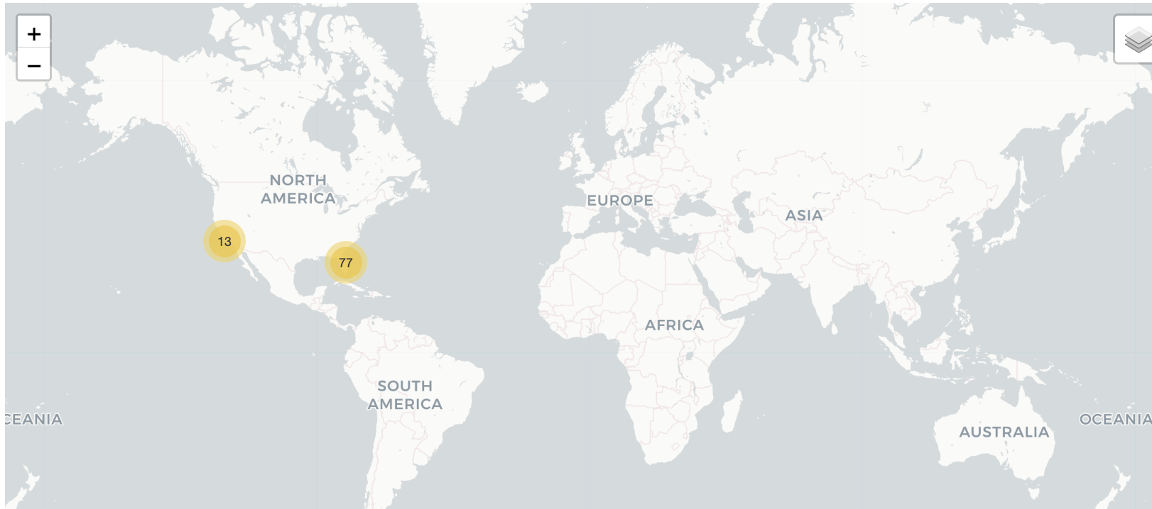
Color-Labeled Folium Map with Launch Outcomes2
CCAFS SLC 40 and KSC LC 39A have the highest success rates.
VAFB SLC 4E shows more variability, with some failures likely due to the complexity of polar orbit missions.
Insight: Success rates are higher at sites optimized for equatorial launches (CCAFS, KSC).

Slide 37
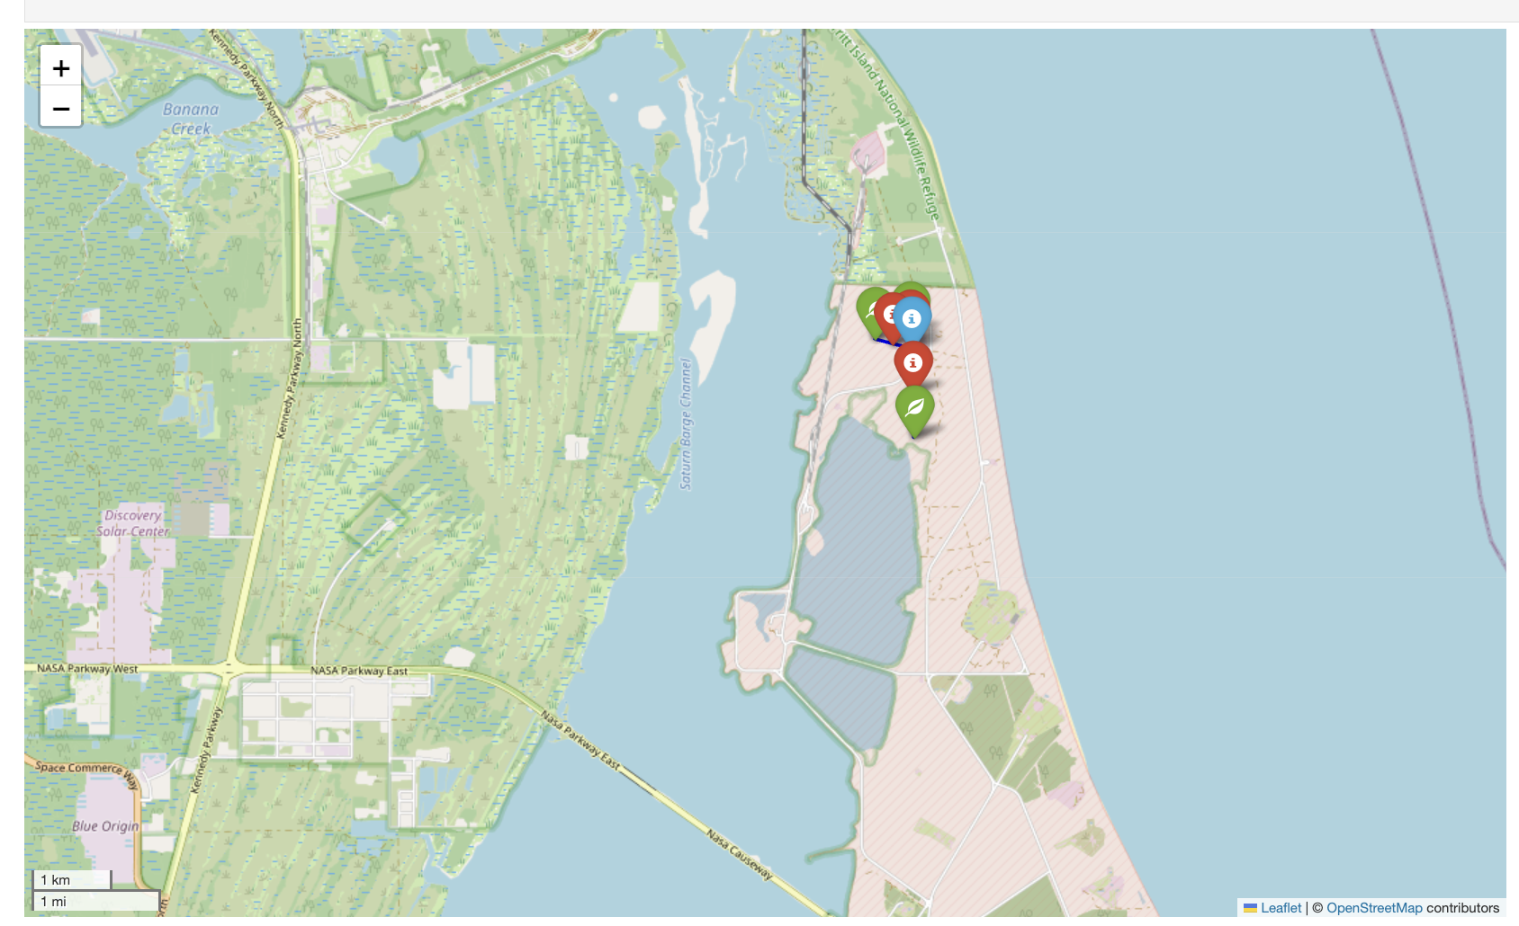
selected launch site along with its proximities (such as railway, highway, and coastline)
CCAFS SLC 40 is strategically located near critical infrastructure:
Railway and Highway: Facilitate efficient logistics.
Coastline: Ensures safety for launches over the ocean.
Insight: Proximity to infrastructure enhances operational efficiency and safety.

Slide 38

Section 4

Slide 39
Launch Success Count for All Sites
CCAFS SLC 40: Handles the majority of launches with high reliability.
KSC LC 39A: Excels in high-profile missions with a 90% success rate.
VAFB SLC 4E: Needs optimization for polar orbit missions.

Slide 40
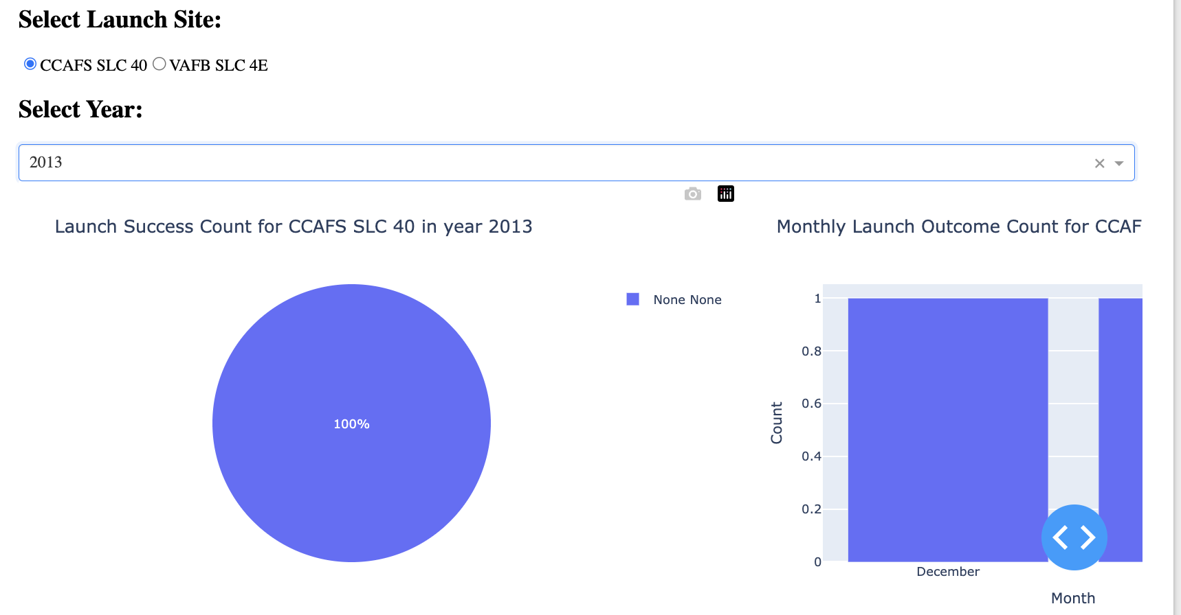
Pie Chart for the Launch Site with the Highest Launch Success Ratio
CCAFS SLC 40 is the most reliable launch site in the dataset.
The 100% success rate highlights SpaceX's operational excellence and mission planning.

Slide 41
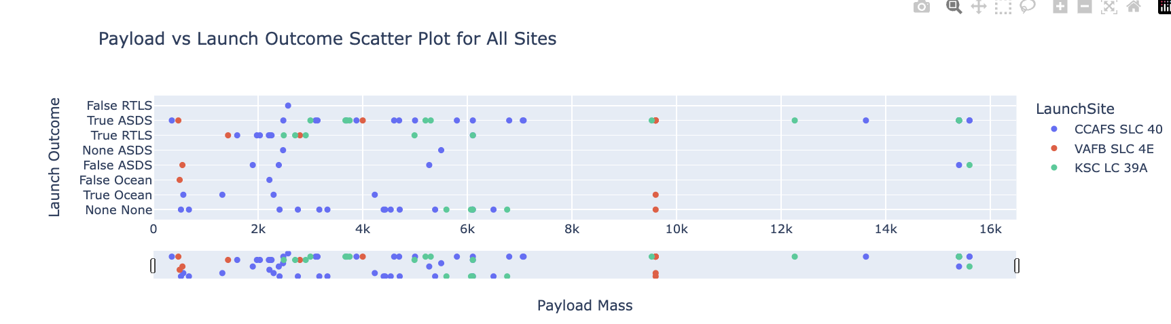
Payload vs Launch Outcome Scatter Plot for All Sites
Optimal Payload Range: 0-8,000 kg has the highest success rates across all sites.
CCAFS SLC 40 and KSC LC 39A are the most reliable sites for heavy payloads.
VAFB SLC 4E struggles with heavier payloads, likely due to polar orbit challenges.

Slide 42

Section 5

Slide 43
Classification Accuracy
Best Model: SVM with 91% accuracy.
Runner-Up: KNN with 89% accuracy.
Decision Tree needs tuning to improve performance.

Slide 44
Confusion Matrix
Strengths: High recall (100%) ensures no successful landings are missed.
Weaknesses: Moderate precision (80%) due to false positives.
Overall: The model is reliable for identifying successful landings but can improve in reducing false positives.

Slide 45
Launch Site Performance:
CCAFS SLC 40 and KSC LC 39A are the most reliable launch sites, with high success rates across payload ranges.
VAFB SLC 4E needs optimization for polar orbit missions.
Payload Insights:
Payloads between 0-8,000 kg have the highest success rates.
Heavier payloads (>12,000 kg) are more prone to failure, especially at VAFB SLC 4E.
Model Performance:
SVM is the best-performing model with 91% accuracy.
The model has no false negatives, ensuring all successful landings are identified.
Recommendations:
Optimize VAFB SLC 4E for heavier payloads and polar orbits.
Use SVM for future predictions due to its high accuracy and reliability.
Continue leveraging CCAFS SLC 40 and KSC LC 39A for high-priority missions.
Conclusions

Slide 46
Appendix
Data Sets:
dataset_part_2.csv: Historical launch data.
dataset_part_3.csv: Features for machine learning.
Additional Resources:
Folium Maps: Interactive maps showing launch sites and outcomes.
Plotly Dashboards: Dynamic visualizations for payload and success rate analysis.
Notebook Outputs:
EDA results (e.g., success rates by orbit type).
Model evaluation metrics (e.g., confusion matrix, accuracy scores).
Charts and Visualizations:
Scatter Plots: Payload vs. Launch Outcome, Flight Number vs. Orbit Type.
Bar Charts: Model accuracy comparison.
Pie Charts: Launch success rate by site.
GitHub

Slide 47


